Slide 1
Research in sociology
Lecture 2
Prof. Dr.samira M. Ebrahim
2023-2024

Slide 2
Objectives
At the end of the lecture the students will be able to :
1- Understand the phases of the scientific methods of research
2- understand the advantages and disadvantages of different research methods
3- understand the ethical guidelines that sociologists must take into account as they conduct research.

Slide 3
Approaches to Sociological Research
Using the scientific method, a researcher conducts a study in six phases: asking a question, researching existing sources, formulating a hypothesis, research design, collecting & analyzing data, drawing conclusions and report the results .

Slide 4
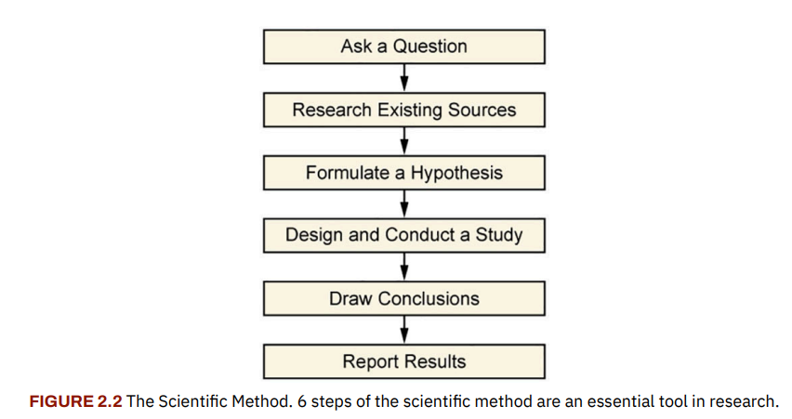

Slide 5
The scientific method is useful in that it provides a clear method of organizing a study.
Some sociologists conduct research through an interpretive framework rather than employing the scientific method.
Scientific sociological studies often observe relationships between variables. Researchers study how one variable influences another.
Prior to conducting a study, researchers are careful to apply operational definitions to their terms and to establish dependent and independent variables

Slide 6
Research methods
Sociological research is a fairly complex process. As you can see, a lot goes into even a simple research design. There are many steps and much to consider when collecting data on human behavior, as well as in interpreting and analyzing data in order to form conclusive results.
Sociologists use the scientific methods for good reasons.
The scientific method provides a system of organization to help researchers plan and conduct a study to ensure data and results are reliable, valid, and objective.

Slide 7
The many methods available to researchers—including experiments, surveys, participant observation, case study, and secondary data analysis—all come with advantages and disadvantages.
The strength of a study can depend on the choice and implementation of the appropriate method of gathering data.

Slide 8
Depending on the topic, a study might use a single method or a combination of methods.
It is important to plan a research design before undertaking a study.
The information gathered may in itself be surprising, and the study design should provide a solid framework in which to analyze predicted and unpredicted data.

Slide 9
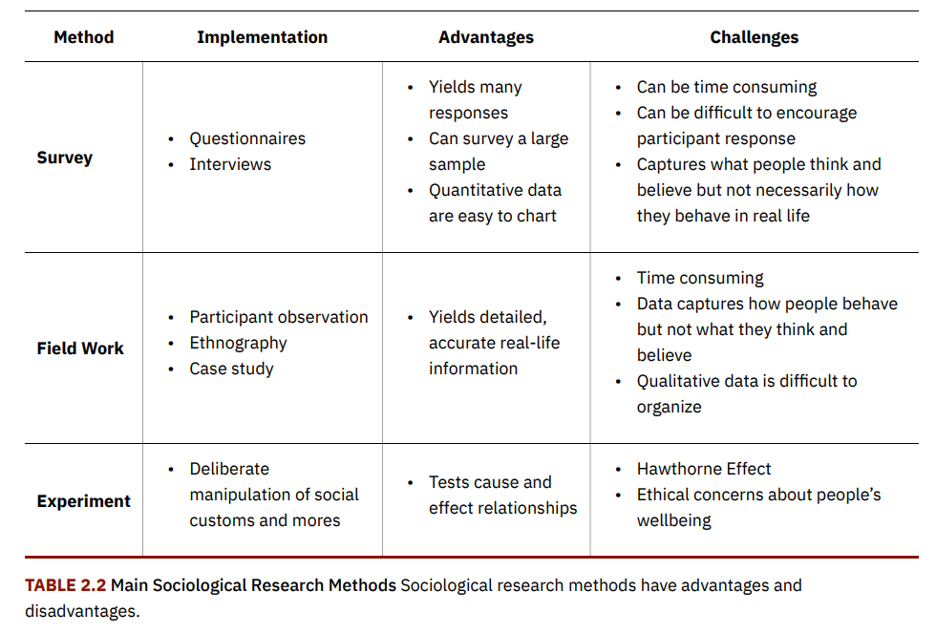

Slide 10
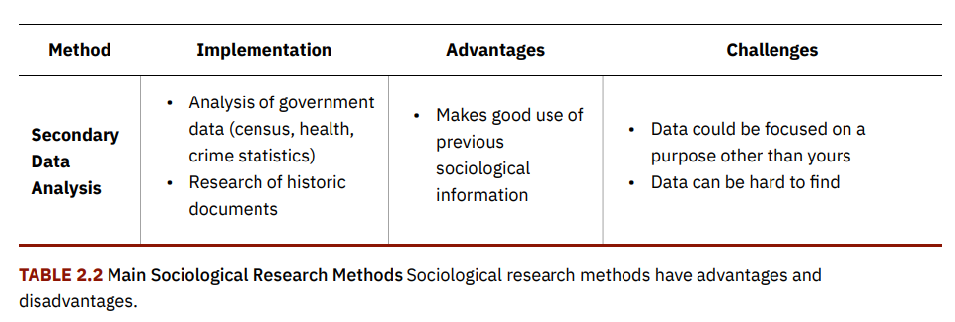

Slide 11
Ethical concerns
Sociologists and sociology students must take ethical responsibility for any study they conduct.
They must first and foremost guarantee the safety of their participants. Whenever possible, they must ensure that participants have been fully informed consent before participating in a study.
The American Sociological Association (ASA) establishes parameters for ethical guidelines that sociologists must take into account as they conduct research.
In some cases researchers did not adhere to ASA guidelines resulting in unethical practices in which humans were caused either physical or psychological harm.

Slide 12
These formal guidelines were established by practitioners in 1905 at John Hopkins University, and revised in 1997. When working with human subjects, these codes of ethics require researchers’ to do the following:
1. Maintain objectivity and integrity in research
2. Respect subjects’ rights to privacy and dignity
3. Protect subject from personal harm
4. Preserve confidentially
5. Seek informed consent
6. Acknowledge collaboration and assistance
7. Disclose sources of financial support

Slide 13
Quiz
1- Enumerate the phases of the scientific methods of research
2- what the advantages and disadvantages of different research methods
3- Enumerate the ethical guidelines that sociologists must take into account as they conduct research.

Slide 14
Thank you

